Slide 1


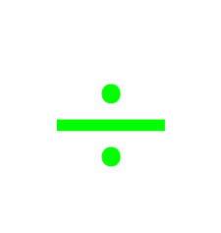





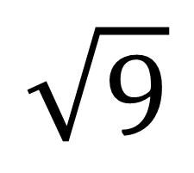
My Angles
Interactive Notebook
Name
Class:
Teacher:
Term 4 Semester 2

Slide 2
Tasks
24
7
30
Essential Question
Questions
Notes
Summary
6

Slide 3
24
7
30
Date
Topic: Measuring and drawing angles
EQ – How do you draw angles using a protractor?

Slide 4
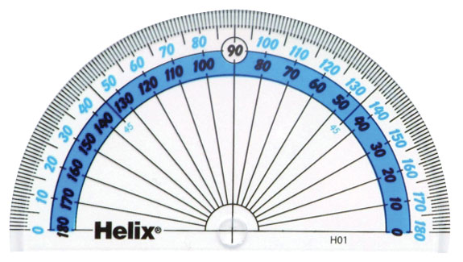
right angle
acute
obtuse
How to
measure angles
using a protractor
reflex
degrees

Slide 5
o
A 180
Protractor
Outside numbers
Inside numbers
Base line
Cross hairs
(where the 2 lines cross)
Two sets of numbers

Slide 6
When measuring
angles, it is important to
know which
numbers to use.

Slide 7
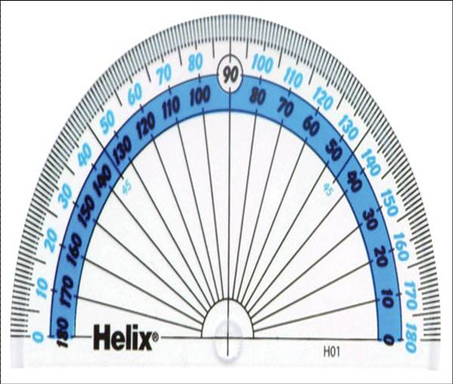
PUT THE ‘CROSS HAIRS’ OF THE PROTRACTOR ONTO THE ANGLE AS ACCURATELY AS POSSIBLE.
FIRST FIND THE BASE LINE
THE OTHER LINE IS RESTING ON THE 40...
BASE LINE
THE BASE LINE IS RESTING ON THE ‘0’ OF THE INSIDE NUMBERS, SO USE THEM.
So the angle is 40°

Slide 8
LET’S TRY ANOTHER ONE
Base line
USE THE INSIDE NUMBERS AGAIN.
The angle is 70°

Slide 9
INSIDE NUMBERS AGAIN
The angle is 120°

Slide 10
THE ANGLE IS FACING TO THE LEFT THIS TIME
Line up the ‘cross hairs’ with the angle.
The base line is on the ‘0’ of the outside numbers this time, so use those ones.
Make sure the base line of the protractor is over the base line of the angle.
The angle is 60°

Slide 11
right angle
acute
obtuse
How to
draw angles
using a protractor
reflex
degrees

Slide 12
Draw an angle of 120°
1) Draw a baseline
2) Line up baseline with cross hairs on protractor
3) Measure 120˚ on inside numbers and mark with a dot
4) Draw a line from the dot at 120˚ to the base line.

Slide 13
Draw an angle of 55°
1) Draw a baseline
2) Line up baseline with cross hairs on protractor
3) Measure 55˚ on inside numbers and mark with a dot
4) Draw a line from the dot at 55˚ to the base line.

Slide 14
Drawing angles:
https://www.youtube.com/watch?v=qXU7ZY1i9Sk

